Slide 1
My Flat Shapes, Angles and Lines Interactive Notebook
Name
Class
Term 3 Semester 2

Slide 2
Contents
Formula Page
Page
Date
Description
2
3

Slide 3
Tasks
24
7
30
Essential Question
Questions
Notes
Summary
10
11

Slide 4
24
7
30
Date
Points, Lines and Angles
EQ – How do I name and represent Points, Lines and Angles?
What is a point?
A representation is a dot labelled with a capital letter.
Note: A point has no width, length or height.
Eg: P this is how we might represent the point P.
What is a line?
A representation is a straight edge which continues forever in both directions, it is named by two points that it goes through.
Note: A line has length but no width or height.
A B
The line in the diagram is labelled AB.
11

Slide 5
24
7
30
Date
Points, Lines and Angles
EQ – How do I name and represent Points, Lines and Angles?
What is an angle?
An angle is made up of two parts of lines joining at one point called a vertex. It can be named by the points on the lines. The point of the vertex is always in the middle.
P
Q
R
This angle is labelled ∠PQR or ∠RQP
Note: the vertex Q is always in the middle.
11

Slide 6
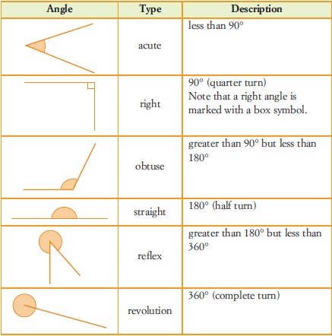
24
7
30
Date
Points, Lines and Angles
EQ – How do I name and represent Points, Lines and Angles?
How to classify angles?
Angles may be classified according to their size.
11

Slide 7
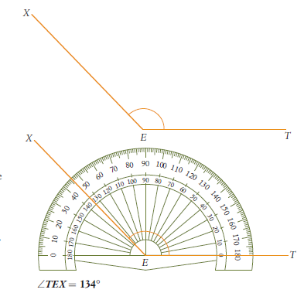
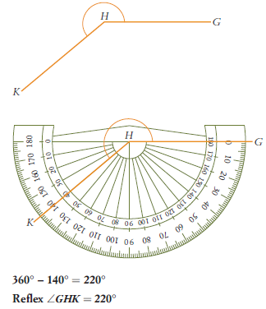
24
7
30
Date
Points, Lines and Angles
EQ – How do I name and represent Points, Lines and Angles?
Working out the size of angles?
Always start with one line on the zero 0° point and measure around the protractor.
Zero on inside circle
Zero on inside circle
Start on exercise 3.1 page 99 – 106 of your text book.

Slide 8
Notes Review
24, 7 ,30
Date
Title
Essential question
Notes complete
Notes complete with colour and diagrams
Questions completed
Contents page filed in
Formula page filled in

Slide 9
Homework
Review your notes and write a summary answering the essential question.

